Slide 1
Advanced computing project
--Web Search Engine
Group member:
Xuan He 104466911
Yating Su 104443714
Xinyi Zhou 104534524
Rui Wang 104491717

Slide 2

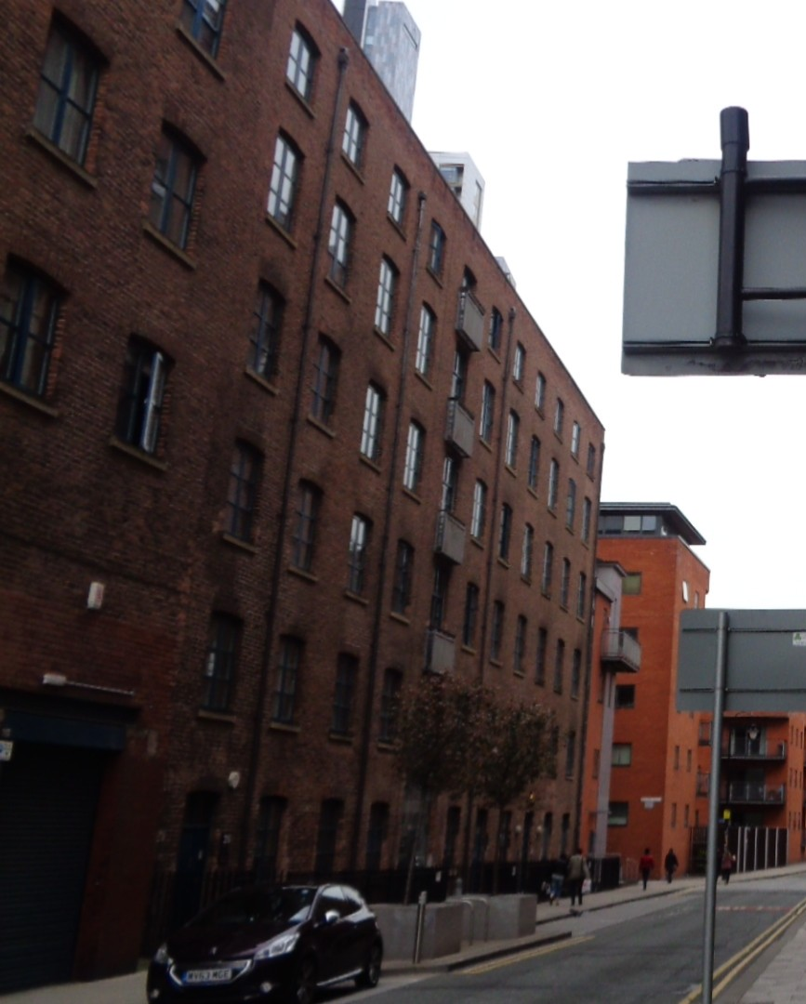
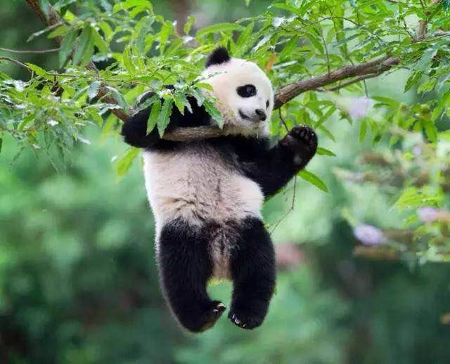





CONTENTS
Translation of HTML to text
Create word dictionary
Page ranking
Pick Fragment using KMP

Slide 3

Translation of HTML to Text

Slide 4

Translation of HTML to text
step1
find files with extension ".htm"
add all files to array list
step2
scrape and parse HTML to Document by jsoup to get information.
step3
Creating the document structure
Write to file with txt extension

Slide 5
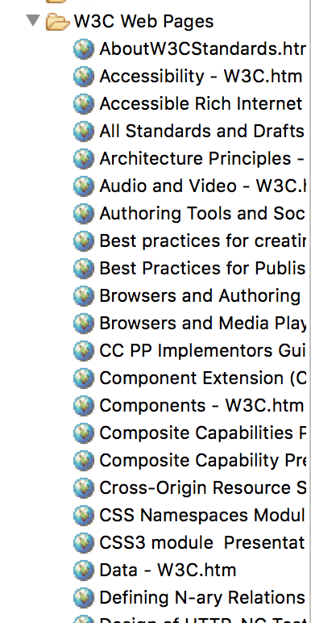
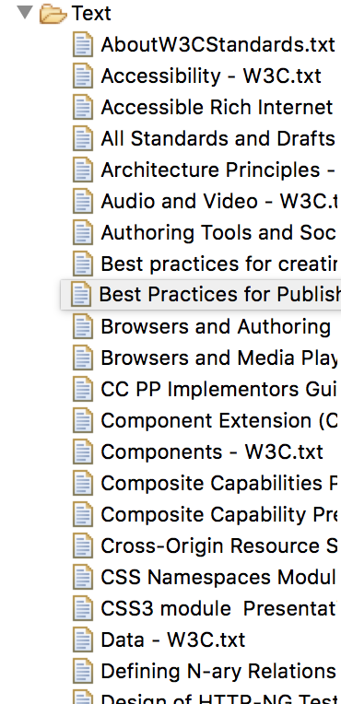
Translation of HTML to text
jsoup

Slide 6


Create word dictionary

Slide 7
Create word dictionary
Deal with the data
Page information
Combine them and build a dictionary

Slide 8
Create word dictionary
Hashing map:
Keyword 1
Hashing function
PageInfo
001
Keyword 2
PageInfo
002
Keyword 3
PageInfo
003
Keyword 4
PageInfo
012

Slide 9
Page ranking

Slide 10
Page ranking
First step :
Searching key words from word dictionary and counting the frequency of key words in each page
hash map
put( key , value ) method is used to store page name and sum frequency of key words in each page into a hash map

Slide 11
Page ranking
Second step :
Ranking page according to the sum frequency of key words of each page
priority queue
comparator
Store pages in descending order

Slide 12
Pick Fragment using KMP

Slide 13
Pick Fragment using KMP
The segment contain:
Page name
Repeat time
A short content that search word located
WHY using KMP：
Quick match
Efficient running time
Don’t need to start comparing from the next position direct jump to the search positon

Slide 14
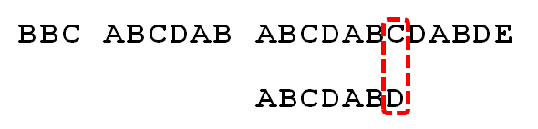
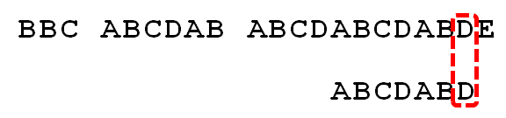
Pick Fragment using KMP
When mismatch D, you actually know that the first six characters are "ABCDAB". The idea of ​​the KMP algorithm is to try to use this information instead of moving back to the position that has been compared, increasing efficiency.
In this case, not move 1 positon but move 4 position to d
By using Partial Match Table
Avoid redundant comparison when pattern string has repeat segment. Eg ABCDABD

Slide 15
Pick Fragment using KMP
Read content of top 10 ranked pages into string
Use KMP algorithm to find position
1. Search method try to find the first match position
2. Search all method find first 5 match position
2.1 Delete substring before current match
2.2 Move forward to next match
3. Keep result in result List map:
(searched words and first 5 match positions)

Slide 16
Pick Fragment using KMP
FragmentPicker method:
1.Locate start and end positions
2.Extract content between the two positions
3.About 300 words
4.Store the content in a string
5.Return to resultList map
6.Output String of the content

Slide 17

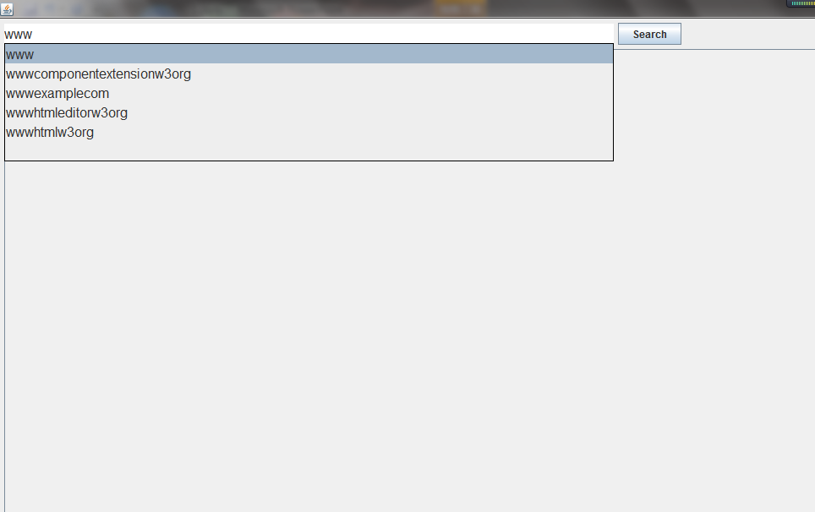
Next Plan —— UI design
Language : java, swing
Search assistance:
use an Editable Combo Box
call prefix search on TST
Search method:
Call Page Ranking to get the top 10 result of the best match pages.
Call FragmentPicker to return the fragment that content the key words in the page .
Difficulties:
Data in the combo box in swing can not be stored after edit and can only be associate with the selections.
Kmp method only returns the first result.
memory usage will be very high if using string to hold the data in the FragmentPicker.

Slide 18
Thank you

